Slide 1
2016 08 LP-Teos RTC OOS
Target < 6/Q
Represent by:
115/11/07
Notes:
115/11/07

Slide 2
現行 TEOS PTC O.O.C & O.O.S 規格:
PTC :
O.O.C : 50 ea
O.O.S : 60 ea
1um PTC :
O.O.C : 15 ea
O.O.S : 30 ea
3. AUG: 9次 Fail

Slide 3
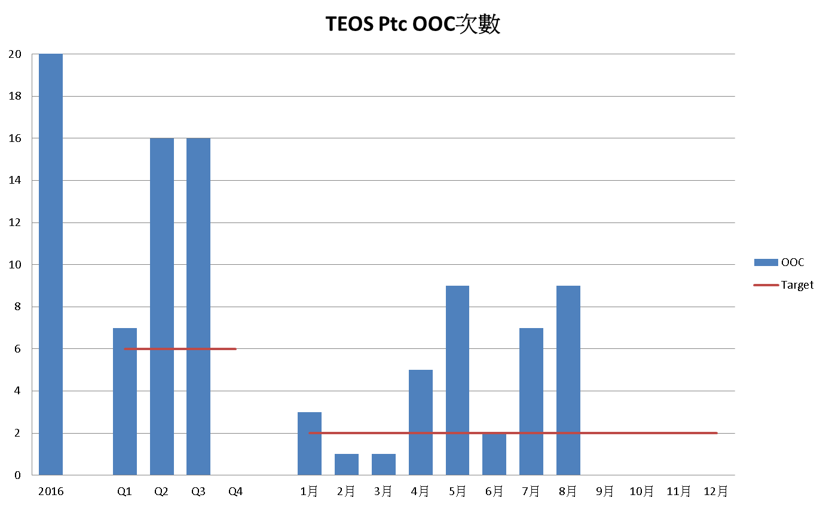
Notes:
115/11/07

Slide 4
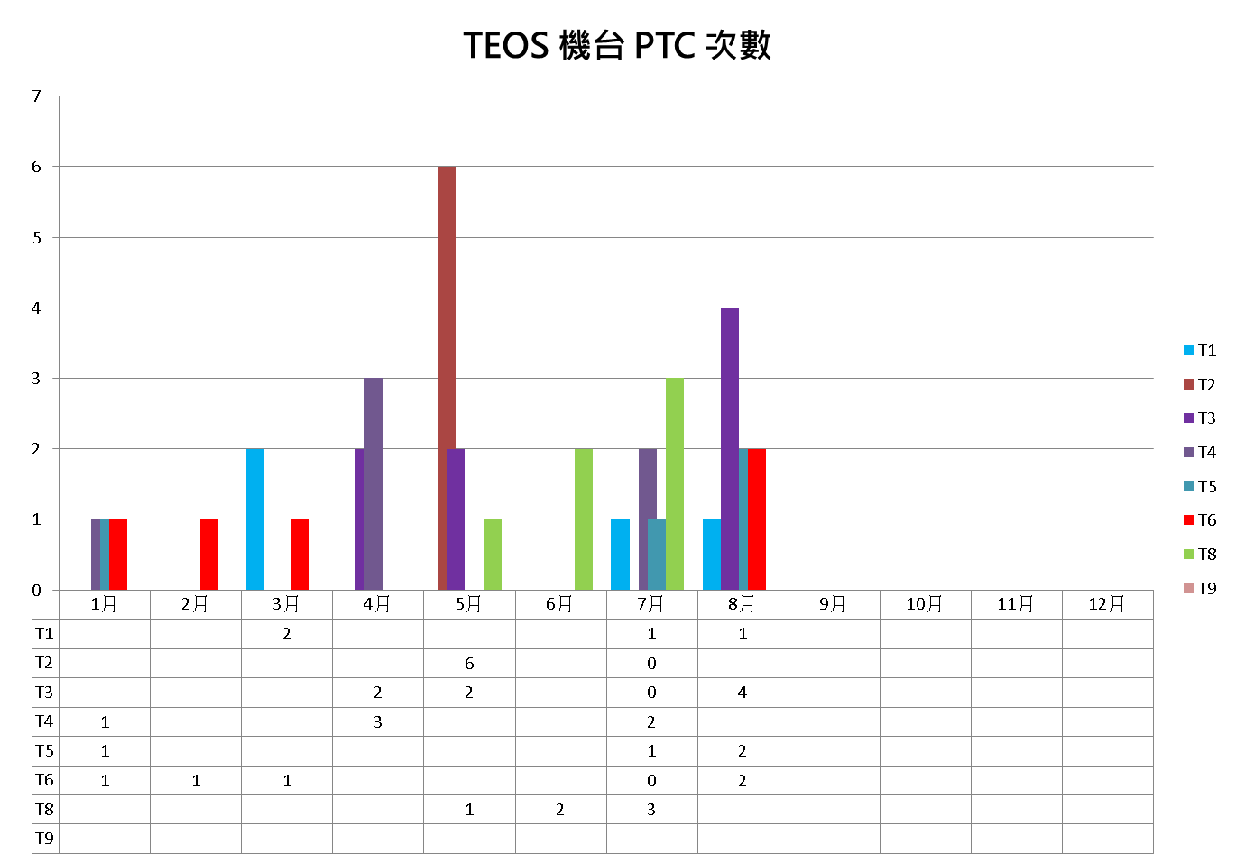

Slide 5
8月份 LP-TEOS PTC OOS 共 9 筆
PTC_1_UM_C6 | LP-T1 | 20160824 03:01:59 | PTC: 58 / 37
PTC_1_UM_C1 | LP-T3 | 20160822 09:37:49 | PTC: 155 / 119
PARTICLE_C1 | LP-T3 | 20160822 09:37:49 | PTC: 155 / 119
PTC_1_UM_C1 | LP-T3 | 20160828 06:11:27 | PTC: 167 / 78
PARTICLE_C1 | LP-T3 | 20160828 06:11:27 | PTC: 167 / 78
PARTICLE_C4 | LP-T5 | 20160813 15:17:43 | PTC: 261 / 87
PTC_1_UM_C4 | LP-T5 | 20160813 15:17:43 | PTC: 261 / 87
PARTICLE_C4 | LP-T8 | 20160810 19:05:12 | PTC: 142 / 71
PTC_1_UM_C4 | LP-T8 | 20160810 19:05:12 | PTC: 142 / 71

Slide 6
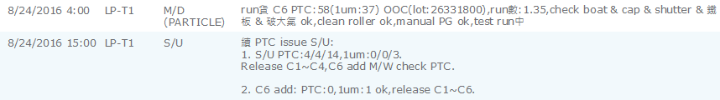
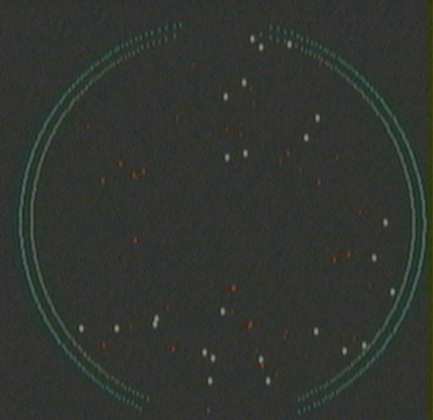
8/24 T1 C6 :58/ 37

Slide 7
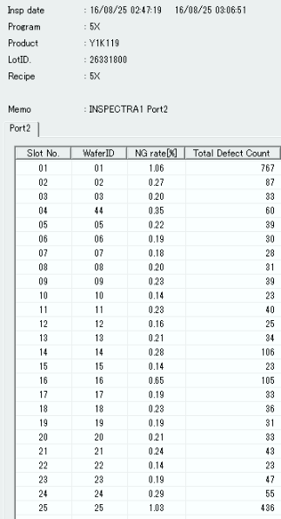
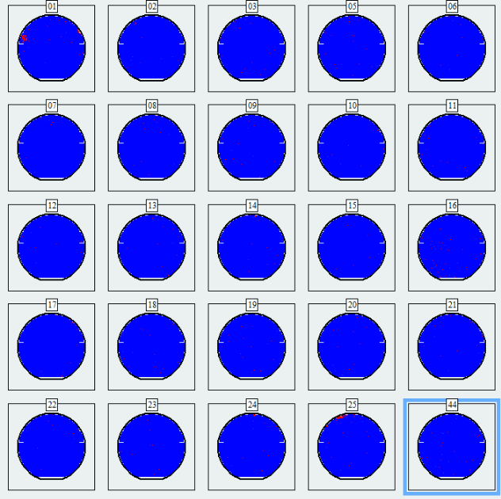
S200 module support
Y1K119-26331800-7412_op
AOI scan defect rate damping at 0.2~1.0%區間, no spec
OM check surface defect 2成, others by under issue
AOI scan defect rate damping at 0.2~1.4%區間, no spec
OM check surface defect 2成, others by under issue

Slide 8
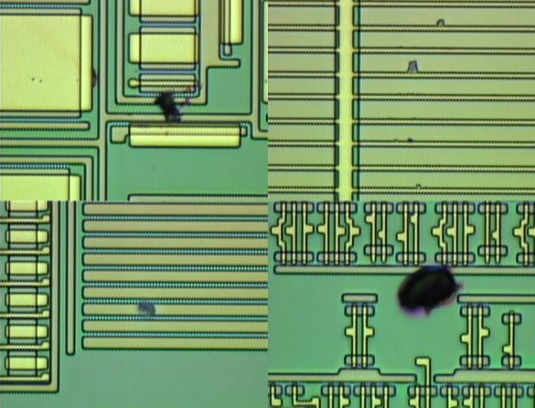
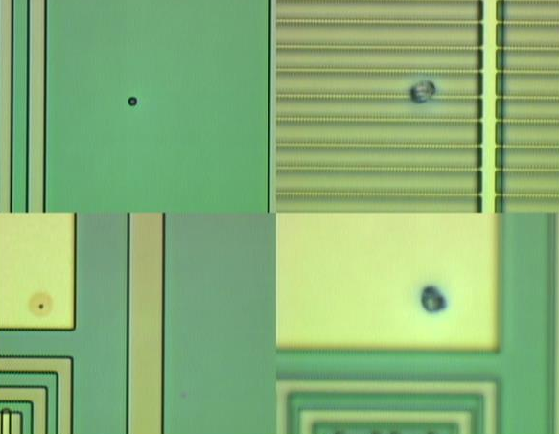
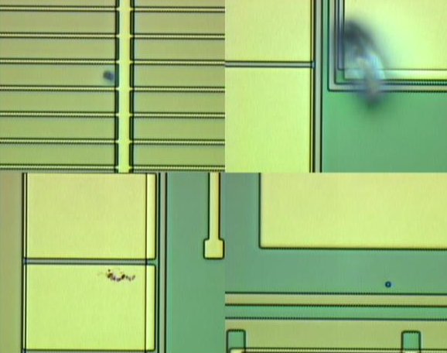
Y1K119-26331800-7412_op OM check
#1
#4

Slide 9
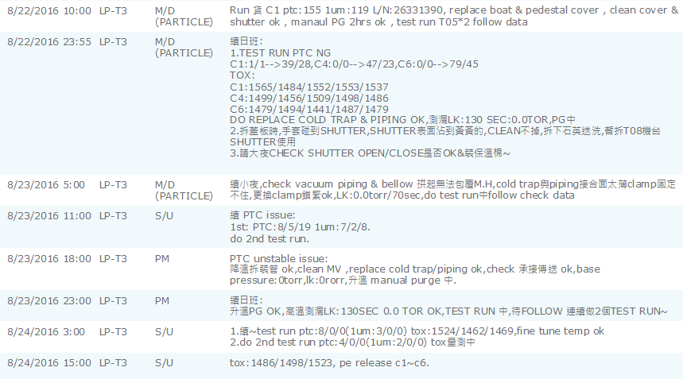
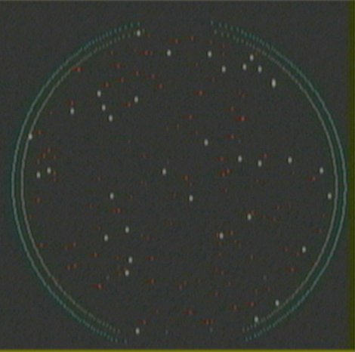
8/22 T3 C1 :155/ 119

Slide 10
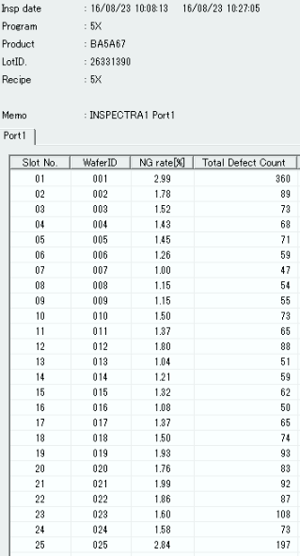
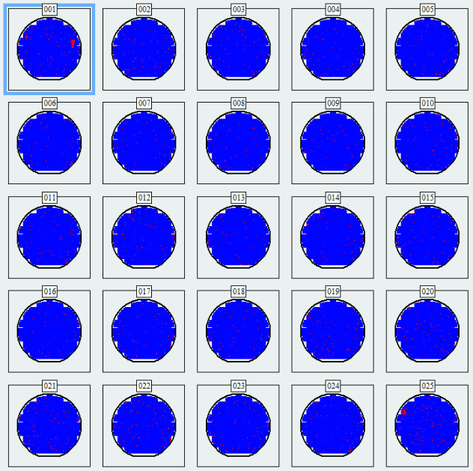
S200 module support
BA5A67-263321390-7412_op
Under
issue
Under
issue
AOI scan defect rate damping at 1~2%區間, no spec
OM check surface defect 4成, others by under issue

Slide 11
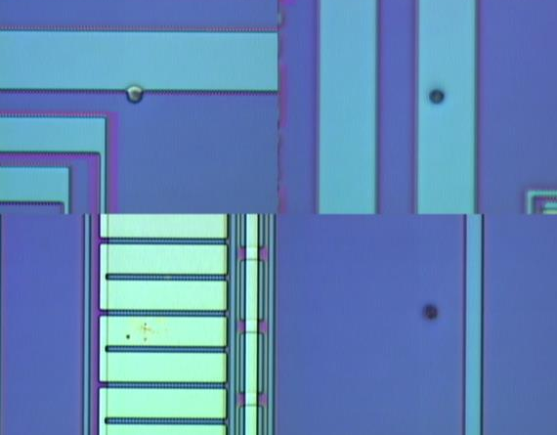
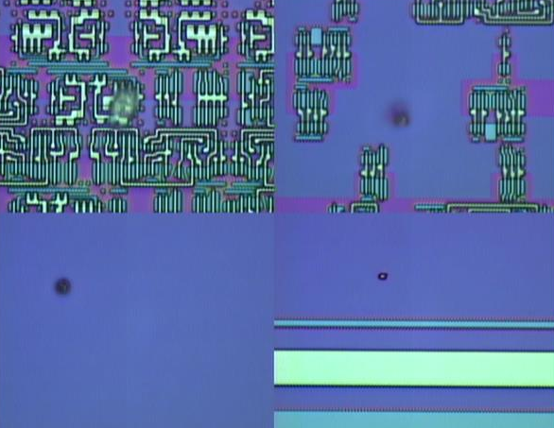
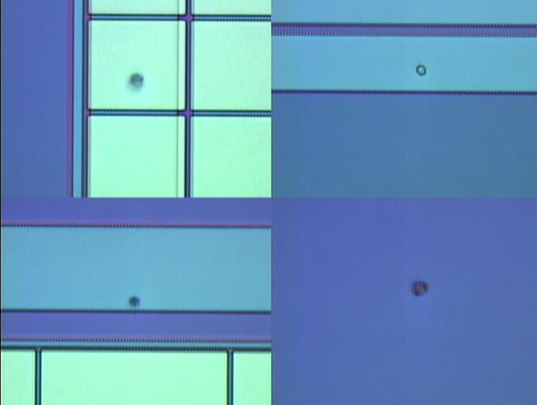
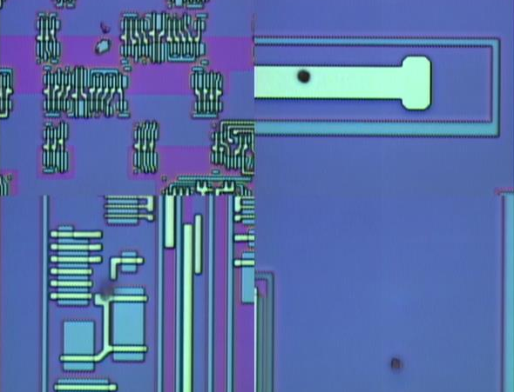
BA5A67-263321390-7412_op OM check
#1
#25

Slide 12
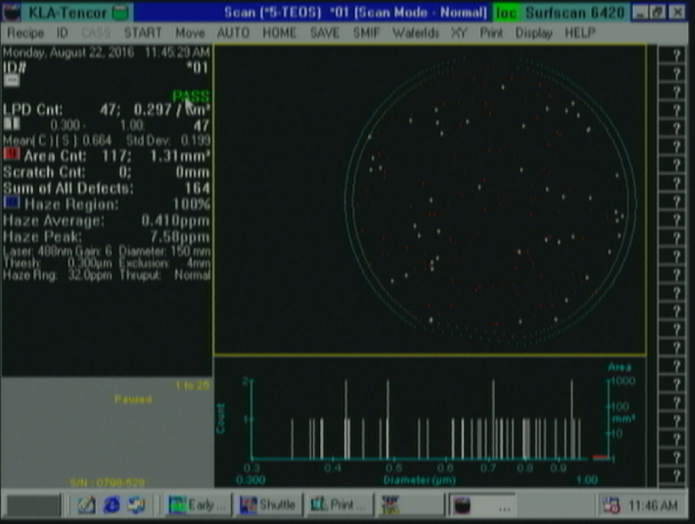

Slide 13
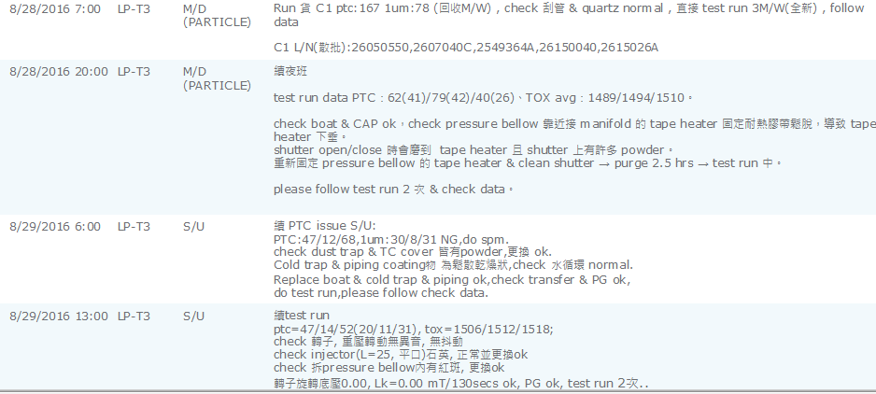
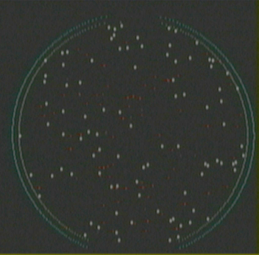
8/28 T3 C1 :167/ 78

Slide 14
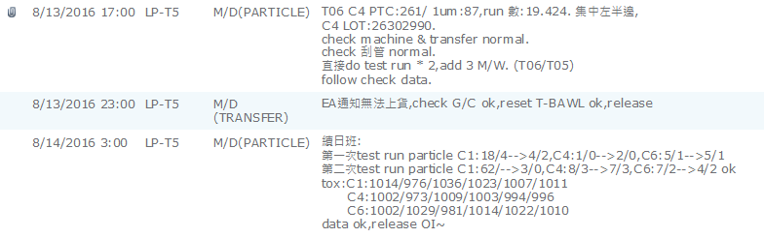
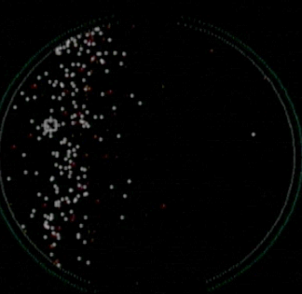
8/13 T5 C4 :261/ 87

Slide 15
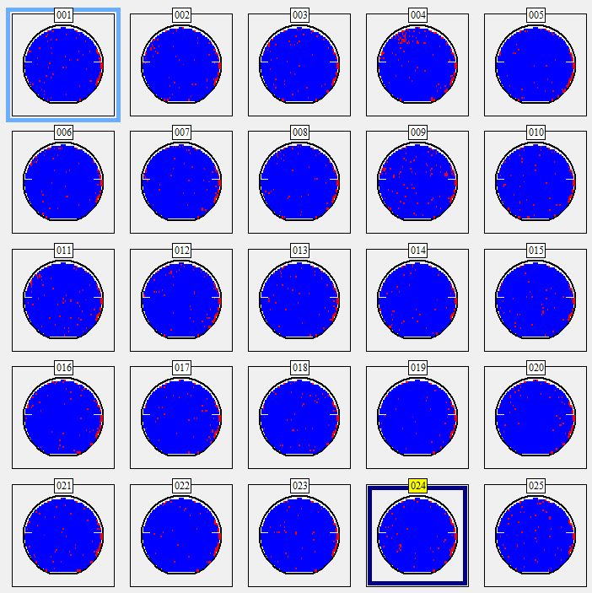
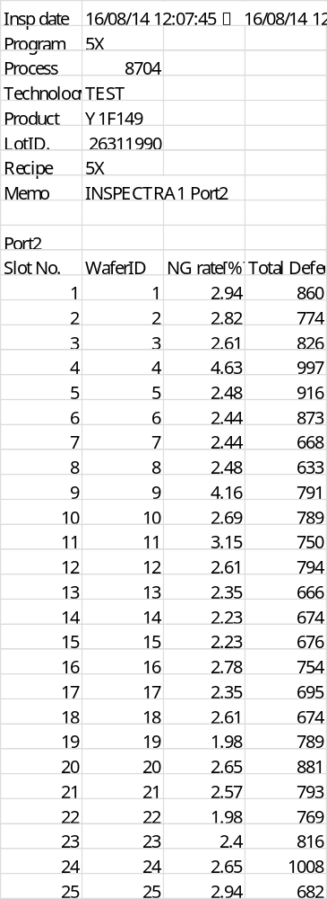
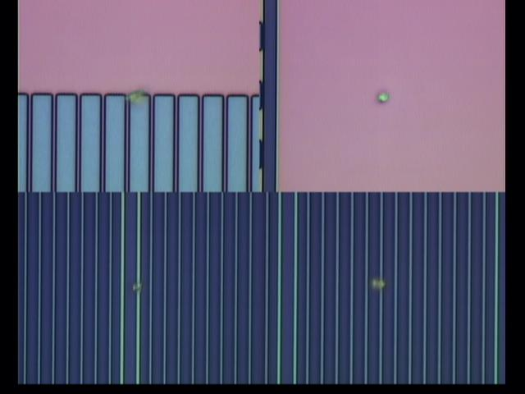
26311990-8704-04
Summary
1) S210 module support for LP-T5 PTC OOS verify lot
Y1F149-26311990-8704 Def% 2~4%(no spec)
2) OM check #04 is LP-T5 PTC impact
3) Product cat S200 check, Keep monitor!!

Slide 16
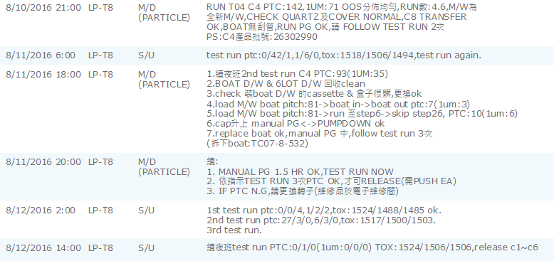
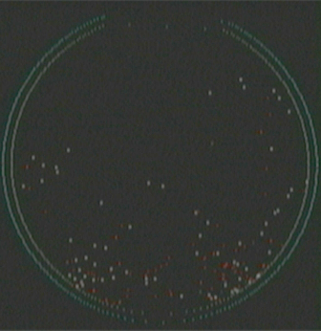
8/10 T8 C4 :142/ 71

Slide 17
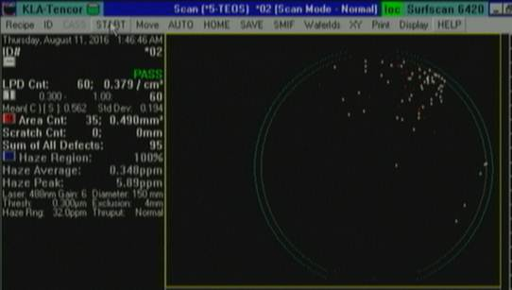
LP-T8 C4 PTC OOS map
PTC map Keep at u-key position

Slide 18
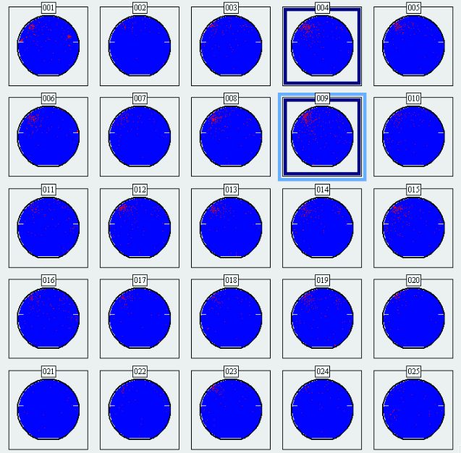
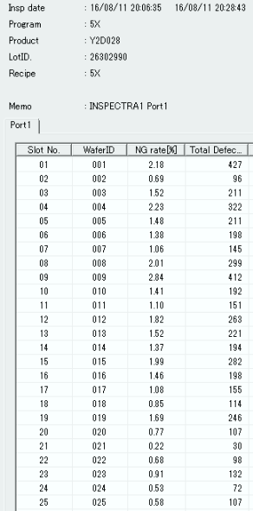
26302990-Y2D028-7412_op
AOI scan defect rate:0.2~2.8% (no spec)
OM check defect source by surface issue ~9成
Please S200 check LP-T8, product for S200 PE check

Slide 19
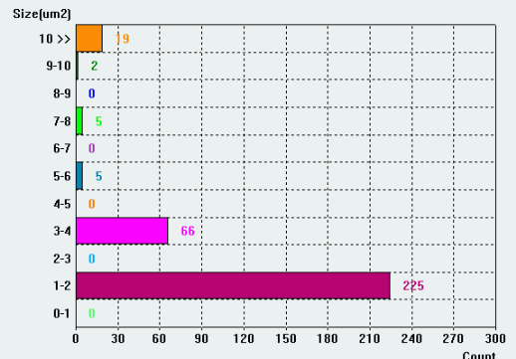
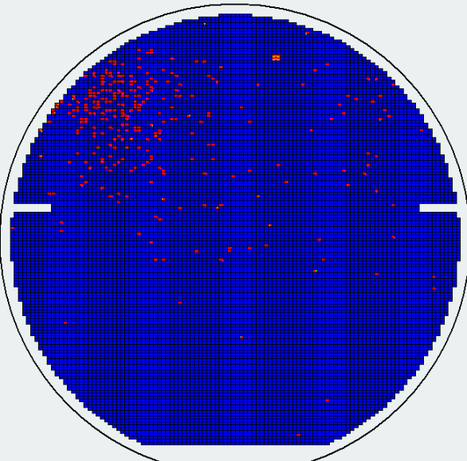
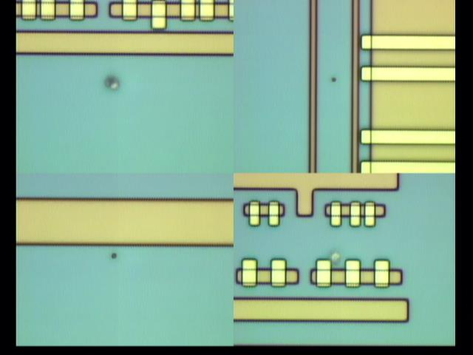
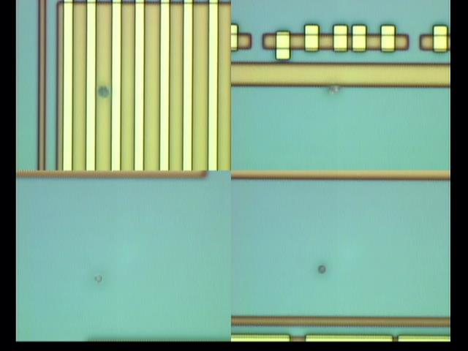
26302990-Y2D028-7412_op #4 map
OM check defect source by surface issue ~9成

Slide 20
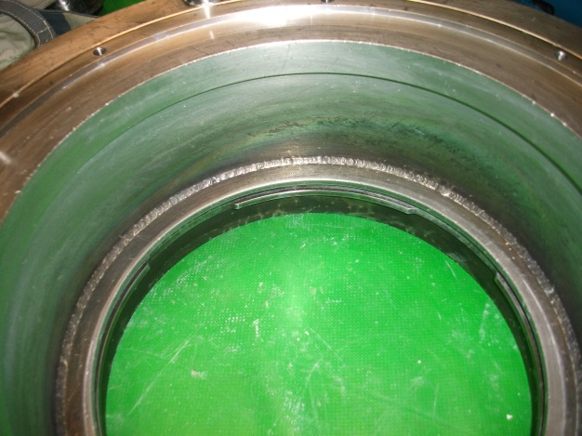
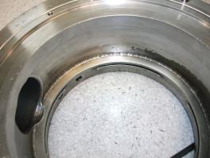
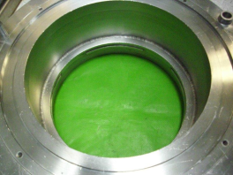
4.改善方案:
目前重點於機台面, PM 手法仔細小心，寧可慢也不要重工。
於 5 月 24 起每日檢查與清理 Boat & cap 有無 powder ，狀況良好。
Teos manifold (福田clean)共9顆 已完成清洗， 下機後維持自行清潔。
目前 manifold 及內管 support ring 震盪完上機前請用菜瓜布 clean 再上機。
Teos BPM時更換 pressure bellow。
已更換安裝 Teos cap T/C port 無孔定位石英。
震盪烘烤後
自行菜瓜布clean
福田 clean

Slide 21
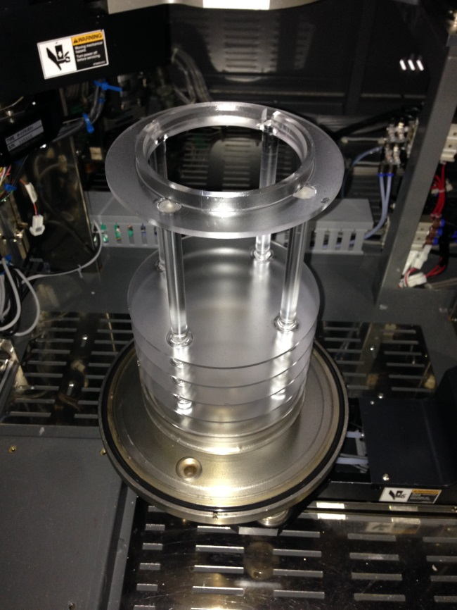
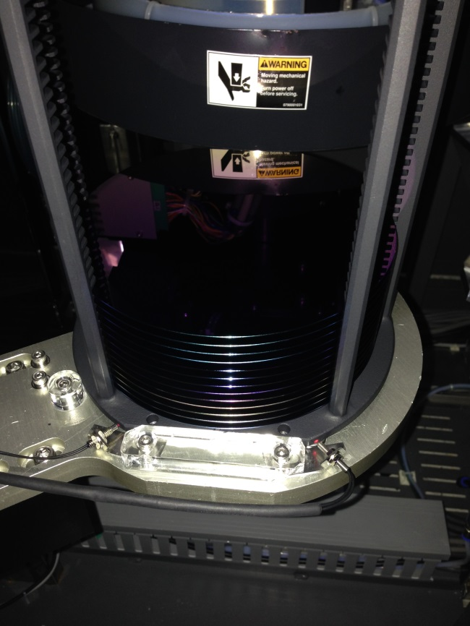
為因應PTC issue 緊急對策:
請每日協助 check cap & dust trap & boat 有無 powder。
如有請用 IPA & 小白布 清理。
Dust trap & O-ring有無powder.
定位螺絲 與 boat 有無powder.

Slide 22
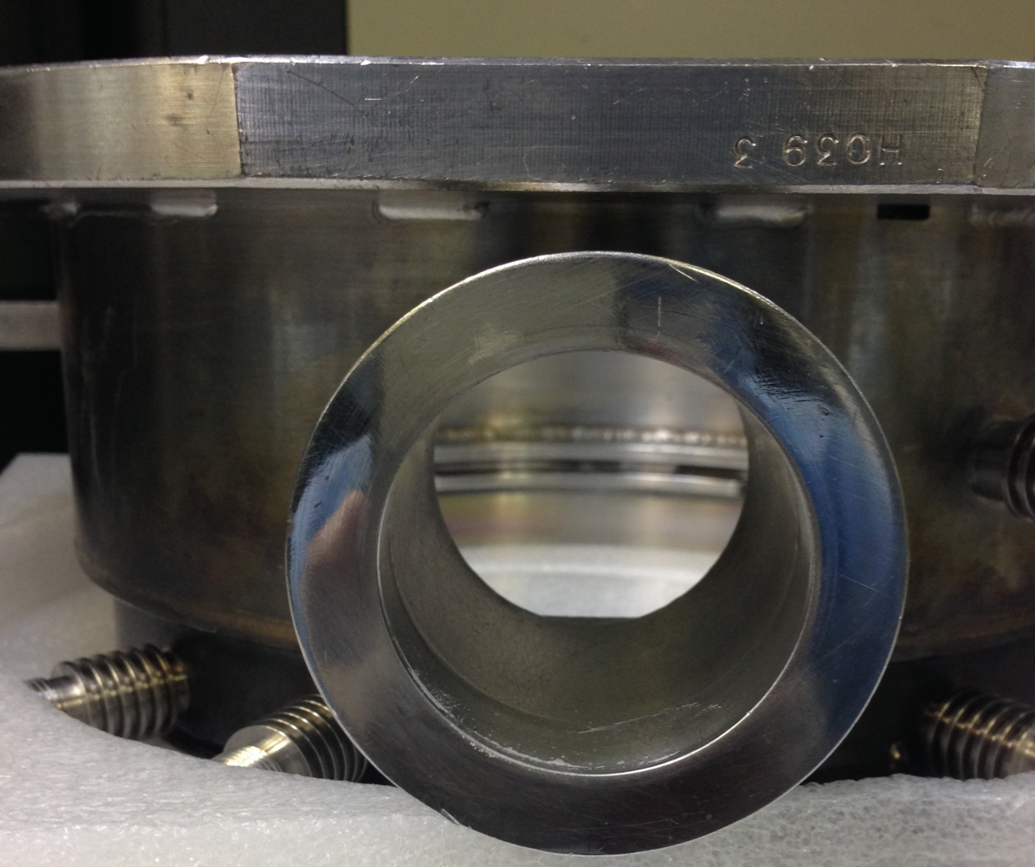
2. Spm 如有清理 manifold 接口 coating 物，請務必打開shutter，
用 Low vacuum 清理時，建議轉接小管，避免回灌問題~~

Slide 23
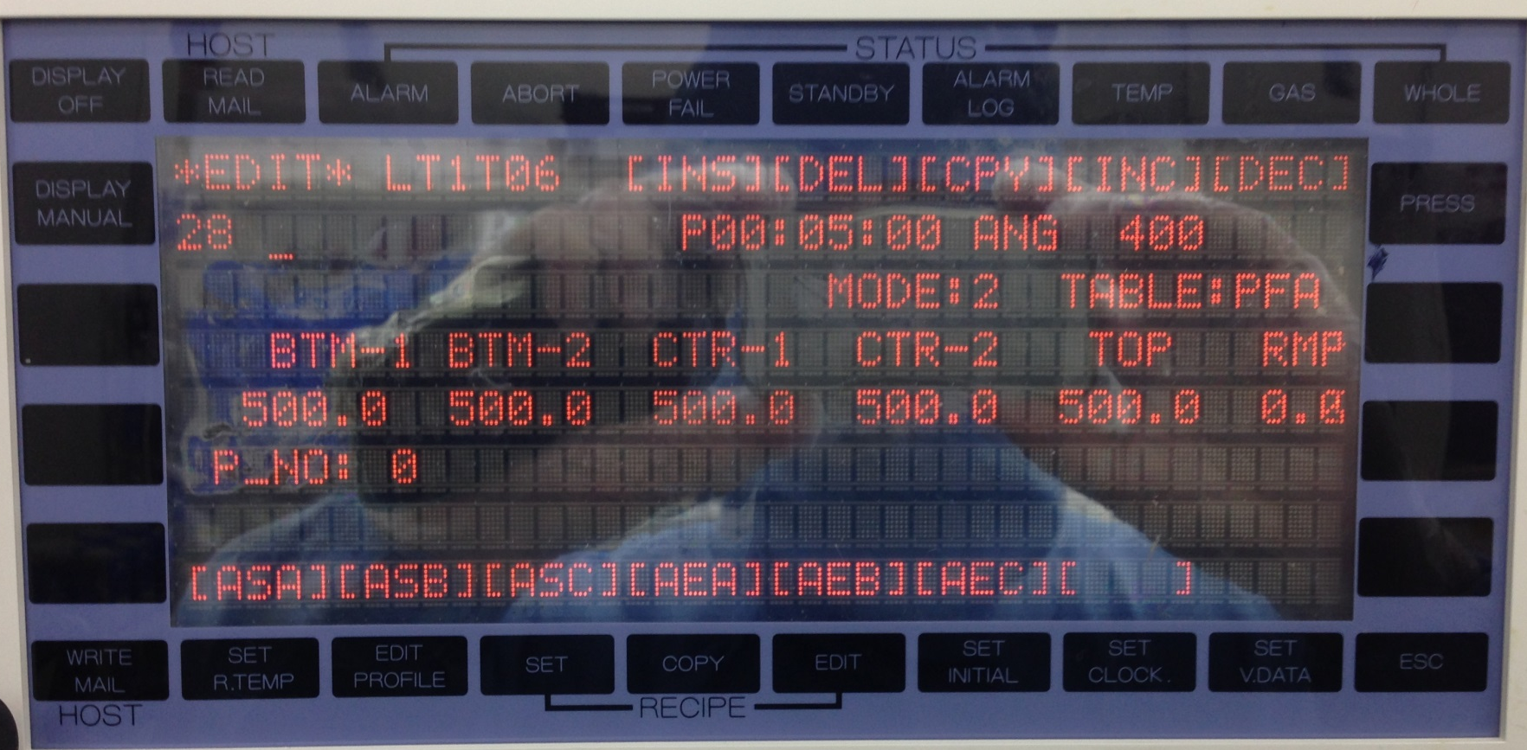
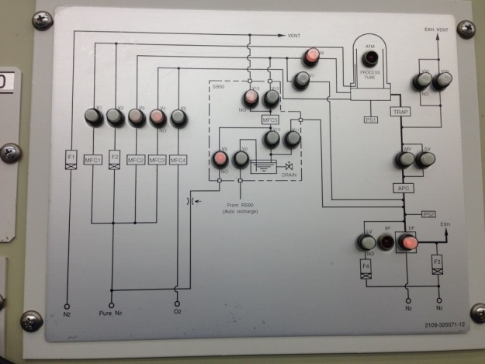
3. PM後 PG，如用auto boat out，
請將程式由step.4大抽後 skip 到 step.24 破大氣。
減少回灌發生。

